Slide 1


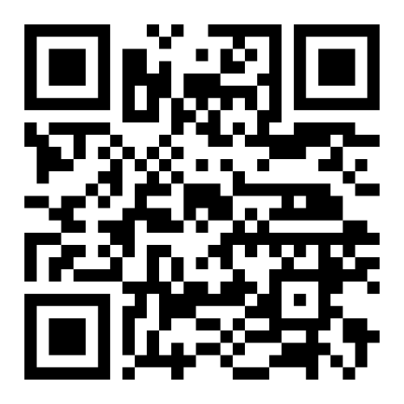
Radiant Hope Biblical Counseling
Christ-centered, Scripture-driven counseling for individuals, couples, and families.
Not therapy. Not self-help. Just the truth spoken in love.
Need Biblical Counseling?
Visit:
www.RadiantHopeBiblicalCounseling.com

Slide 2

Radiant Hope Biblical Counseling
Christ-centered, Scripture-driven counseling for individuals, couples, and families.
Not therapy. Not self-help. Just the truth spoken in love.
Know someone who needs help?
Visit:
www.RadiantHopeBiblicalCounseling.com

